Slide 1
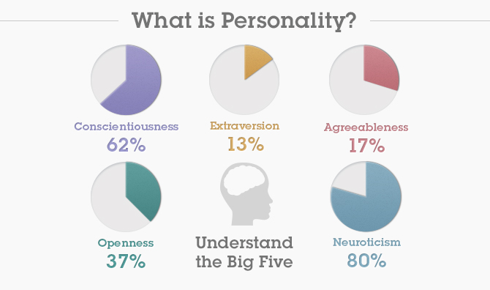
Introduction to The Big Five
While there are hundreds of personality traits that psychologists have been using for over a century, there are really just a few dimensions of variation.
For example, many scales are available to measure depression, anxiety, self-consciousness, and other tendencies toward experiencing frequent negative emotions. However, these scales all correlate strongly with each other as aspects of Neuroticism, a trait of the Big Five.

Slide 2
Introduction to The Big Five
One of the most important measures of personality created is The Big Five Inventory.
Psychologists in the 1960s first began to notice that the same "meta-traits" kept popping up in large studies. In the 1980s the "five factor model" of personality was developed, now called The Big Five, and has become the most important model in personality psychology.

Slide 3
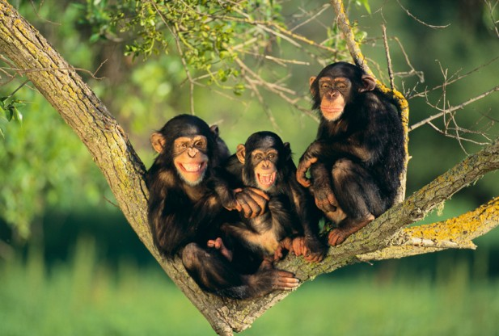
Introduction to The Big Five
It turns out that chimpanzees, dogs, pigs, and even squid can be reliably classified, based on their individual behaviors, on some or all of the five factors.
Variation on these five factors seems to reflect some basic traits on which the brains of animals can vary, such as being set for more or less social interactions (extraversion), or for more or less variety seeking (openness to experience).

Slide 4
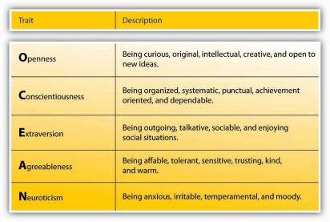
Introduction to The Big Five

Slide 5
Introduction to The Big Five
To learn more about your personality profile I want to introduce you to a website Dr. Ravi Iyer and Dr. Ryan Howell created titled “BeyondThePurchase.Org” which allows individuals all over the world to take free psychology quizzes to find out more about their personality traits.
Once you’ve completed The Big Five quiz, you’ll be able to view your results for each of the five dimensions, and compare those results to others.

Slide 6
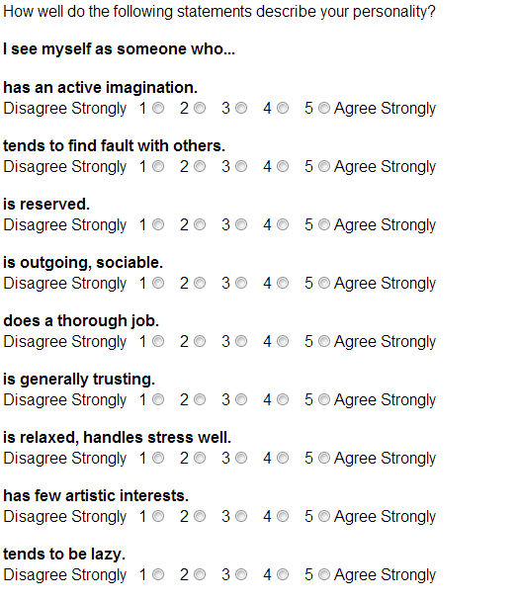
Introduction to The Big Five

Slide 7
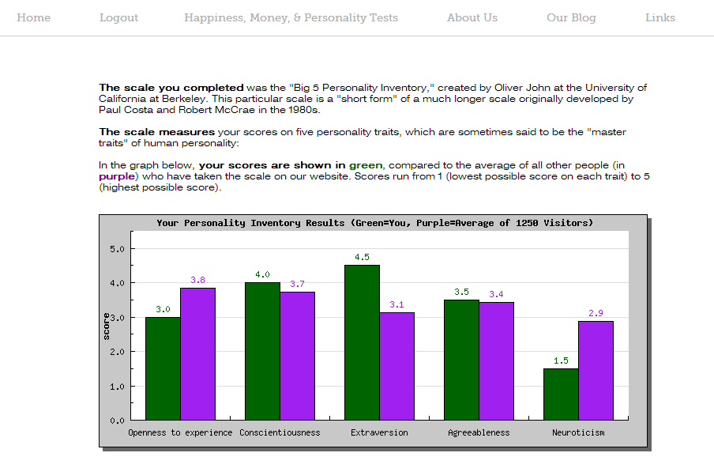
Introduction to The Big Five

Slide 8
Discussion Questions
  If Andy scores high in Openness, will he also score high in Extraversion? Why or why not?
  Think back to the questions asked in The Big Five personality test. Create three additional questions that would help measure one of the five dimensions.
  How might knowing a friend’s scores on each of the Big Five dimensions help you resolve a disagreement? How would you change your behavior if he or she was high in Conscientiousness? Low in Openness?

